Slide 1
Three Dimensional Plotting

Slide 2
3D Plotting
3D line plots – plot3(x,y,z)
can use line specifiers and properties as you do in 2D plots
The three vectors must have same # of elements

Slide 3
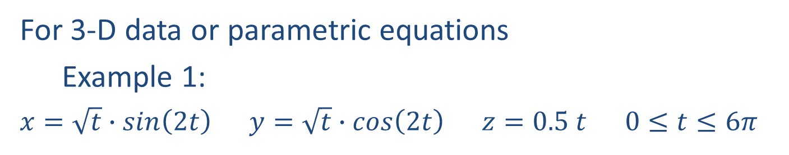
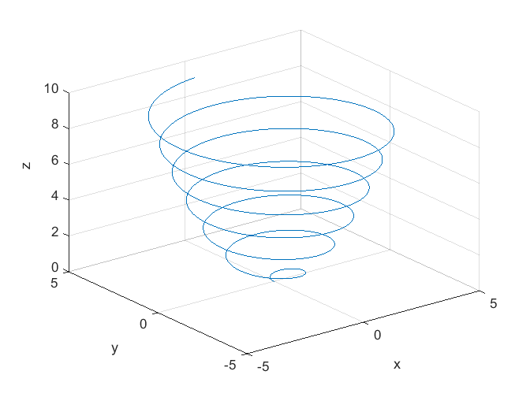
3-D line and scatter plots:
>> t = 0:0.01:6*pi;
>> x = sqrt(t) .* sin(2*t); >> y = sqrt(t) .* cos(2*t); >> z = 0.5*t;
>> plot3(x,y,z)
>> grid on
>> xlabel('x');
>> ylabel('y');
>> zlabel('z');

Slide 4
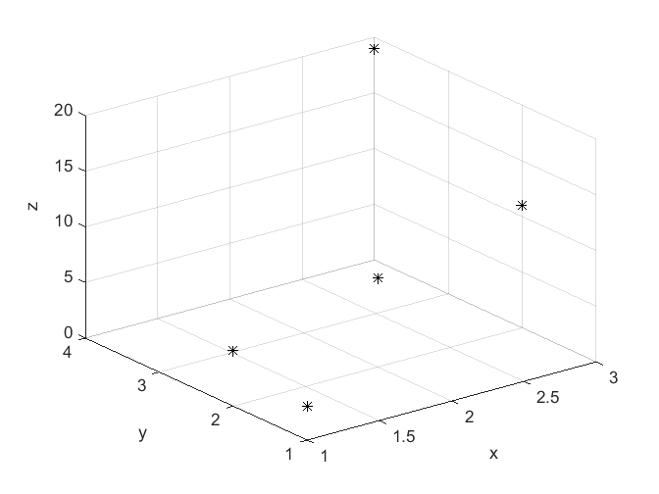
3-D line and scatter plots:
For 3-D data or parametric equations
Example 2 – data values:
(1, 1, 3), (1, 2, 5), (2, 2, 8), (3, 4, 19), (3, 2, 11)
>> x = [1, 1, 2, 3, 3]; >> y = [1, 2, 2, 4, 2]; >> z = [3, 5, 8, 19, 11];
>> plot3(x,y,z, 'k*')
>> grid on
>> xlabel('x');
>> ylabel('y');
>> zlabel('z');

Slide 5

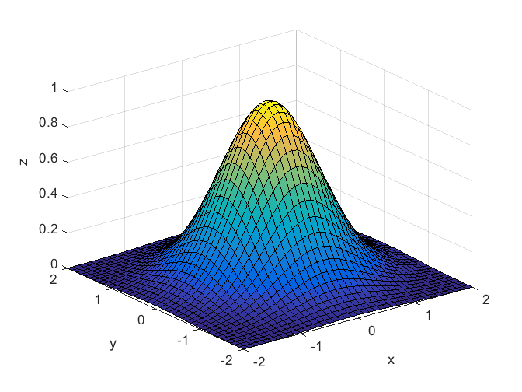
3-D surface plots:
>> xrange = -2:0.1:2; >> yrange = -2:0.1:2;
>> [X, Y] = meshgrid(xrange, yrange);
>> Z = exp(-(X.^2 + Y.^2));
>> surf(X,Y,Z)
>> xlabel('x');
>> ylabel('y');
>> zlabel('z');
meshgrid() expands 1-D range vectors to 2-D matrices of x/y pairs

Slide 6
Mesh and Surface Plots
Where the form is z=f(x,y)
First step – create a grid in the x,y plane using meshgrid function
define range of x and y: x=-1:3, y=1:4
[X,Y]=meshgrid(x,y)
now define Z as a function of X and Y
Z=X.*Y.^2./(X.^2+y.^2)
Once the three matrices exist

Slide 7
Mesh and Surf
mesh(X,Y,Z)
surf(X,Y,Z)
Try this example, but with a smaller increment for the grids, like 0.1
Use xlabel, ylabel and zlabel and title
colormap( c )
grid off

Slide 8
The view command
Determines angle of view of the plot
view(az, el) or view([az,el])
Top view = view(0,90)
Side view = view(0,0) x-z plane
Default- view(-37.5,30)

Slide 9
Here is a cool 3D plot – try it!
[X,Y]=meshgrid(-8:.5:8);
R=sqrt(X.^2+Y.^2)+eps;
Z=sin(R)./R;
mesh(X,Y,Z,'EdgeColor','black')
surf(X,Y,Z)
colormap hsv
colorbar
camlight left; lighting phong

